Slide 1


AP BIO
TOPIC 7.9:
Phylogeny

Slide 2
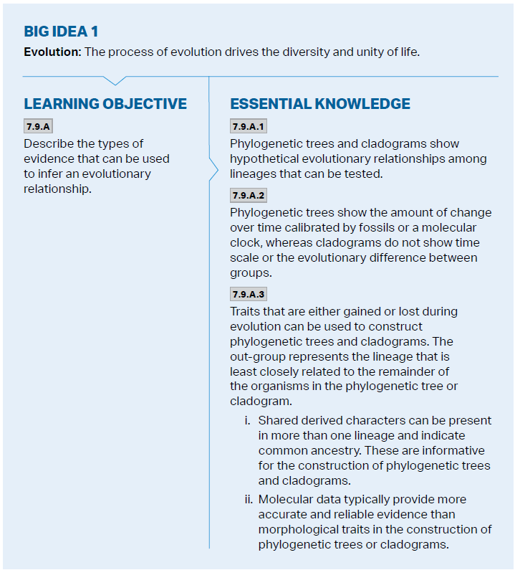
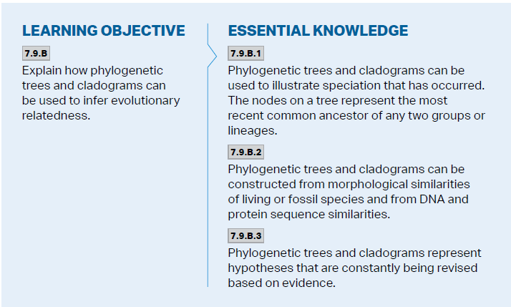
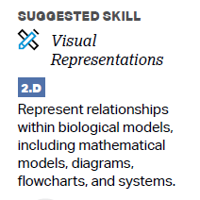
Objectives

Slide 3
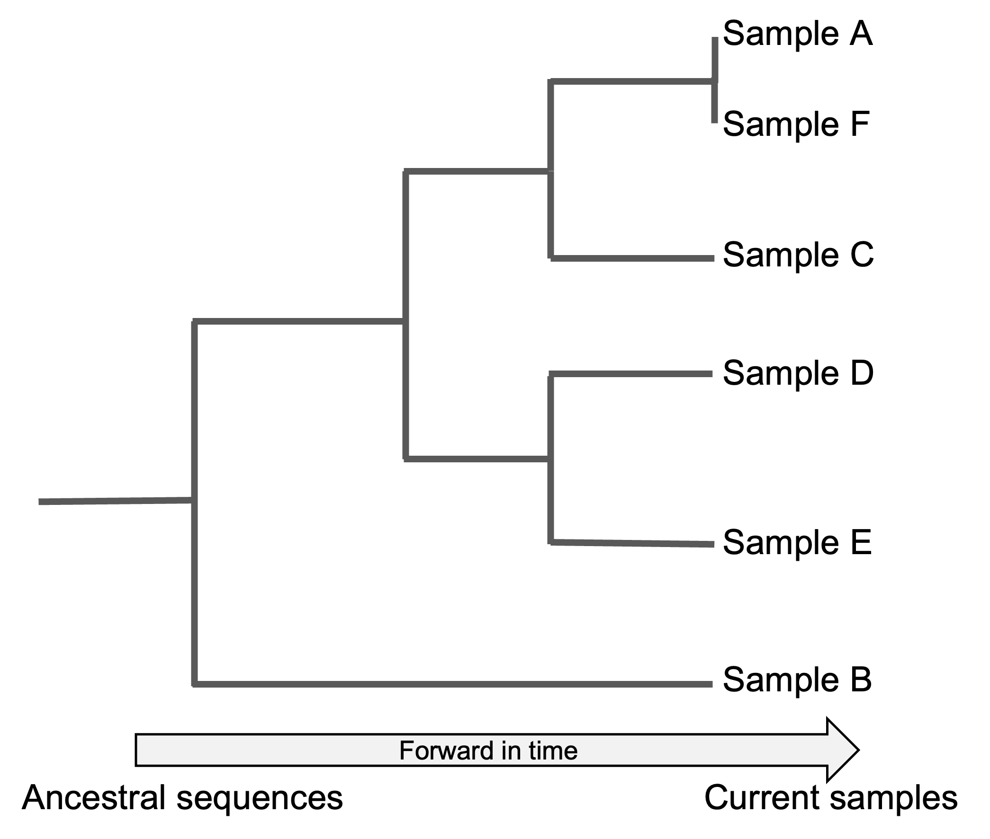
Introduction to Phylogeny
Phylogeny – evolutionary history of a species or group of species
Fossils, morphology (structure), genetic analysis, and molecular evidence used to determine phylogeny (DNA and genetics most accurate)
Phylogenetic trees – branching diagrams that represent hypotheses about evolutionary relationships – each group is known as a taxon
Branch points – where there is a divergence of 2 evolutionary lines
Outgroup – least closely related taxon
Sister taxa – groups closest related

Slide 4
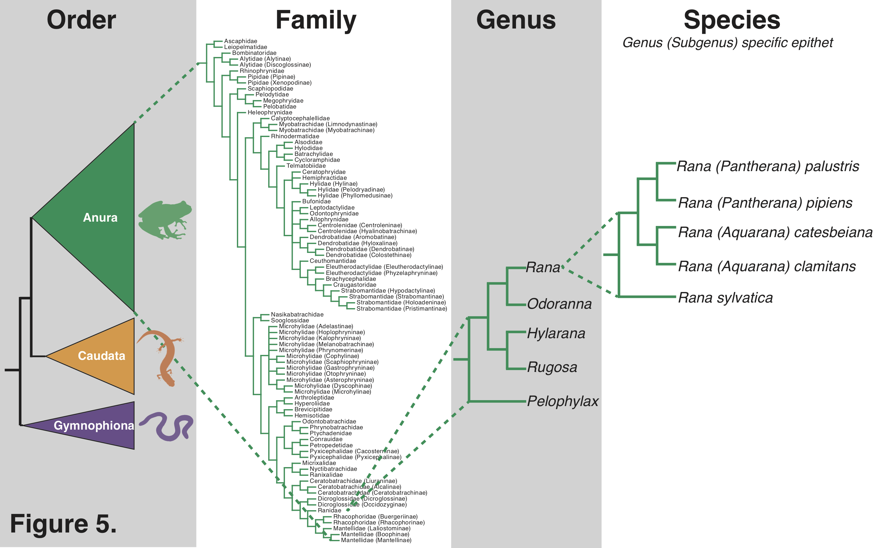
Phylogenetic Trees
Represent patterns of descent (not phenotypic similarity)
Amount of change over time shown by fossils or a molecular clock (measuring absolute time of evolutionary events by rates of mutation)
Show relative time, not all trees contain exact evolutionary dates
Used with taxonomical categories

Slide 5
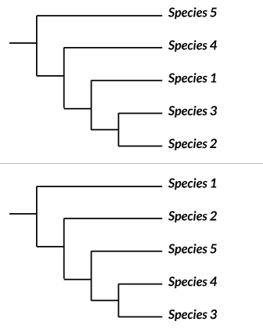
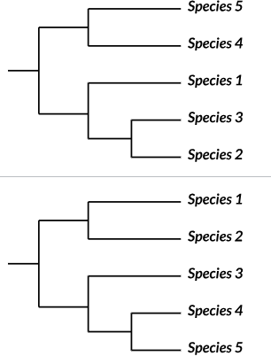
Phylogenetic Tree Practice
Which tree best matches the info shown in the table?
Nucleotide Differences
 | Species 1 | Species 2 | Species 3 | Species 4 | Species 5
Species 1 | 0 | 15 | 15 | 22 | 43
Species 2 |  | 0 | 7 | 35 | 50
Species 3 |  |  | 0 | 27 | 50
Species 4 |  |  |  | 0 | 50
Species 5 |  |  |  |  | 0

Slide 6
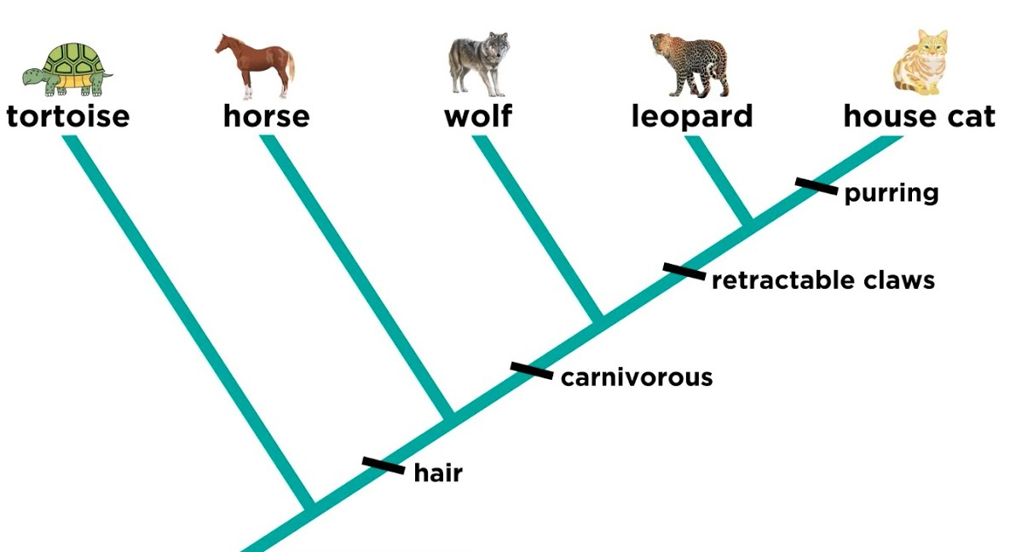
Cladograms
Cladogram – depicts patterns of shared characteristics, forming the basis of a phylogenetic tree (focused on similarities of appearance)
Places species into groups that include an ancestral species and all of its descendants (clades)
Looks at shared derived characteristics – traits found in the most common ancestor and all of its descendants, but not in distantly related groups (hair in mammals)
And shared ancestral characteristics – a trait that originated in an ancestor of the group (backbones in mammals)

Slide 7
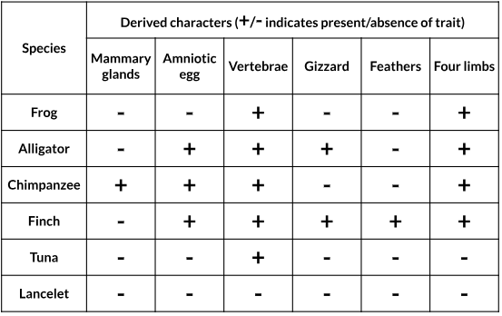
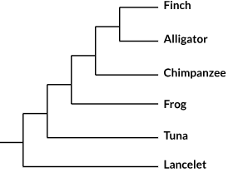
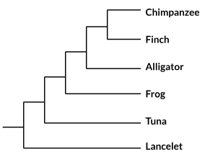
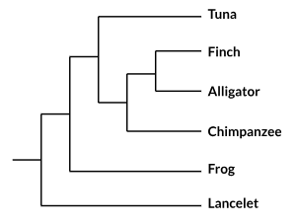

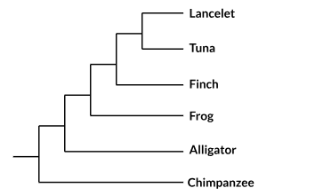
Cladogram Practice
Which cladogram best represents the evolutionary relationship between the species?
*question from Khan Academy

Slide 8
Phylogeny Review
Phylogenetic trees
Cladograms

